Slide 1

Week 1 Introduction to Programming
CO1404 | Introduction to Programming
Dr Daniel Campbell
dgcampbell@uclan.ac.uk

Slide 2
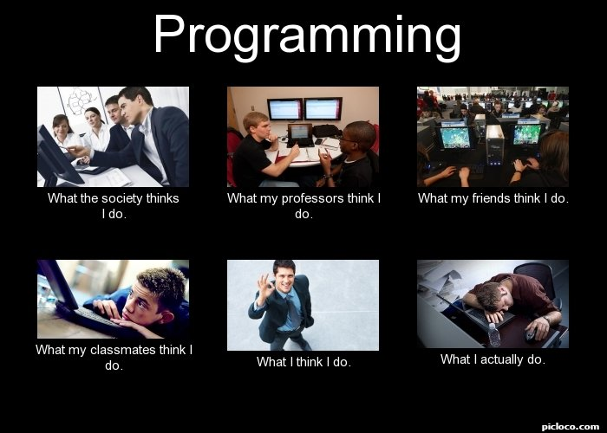

Welcome to CO1404!
I will be your guide

Slide 3
Week 1’s Objectives
Theoretical Objectives
TO.1 : Module overview, tutors, rules of engagement, and expectations.
TO.2 : Brief introduction to programming.
Practical Objectives
PO.1 : Introduce the development environment and programming language C#.

Slide 4

Module Overview
Focuses on the core programming concepts needed by all computing students!
How : CO1404 is delivered over a period of 8 weeks.
1 lecture per week (Monday)
1 lab session (Tuesday or Wednesday)
Content : All content will be made available via Blackboard.
Where : Combination of Online and Physical Classes
Notes:
CONTENT : Some content will not be visible straight away. This is due to it being released over time. For example Answers to labs ect..

Slide 5
You Are Here
Week 1 | Week 2 | Week 3 | Week 4
Introduction to Programming | Constants, Variables, Operators, and Conditions | More on Operators and Conditions. Introduction to Loops | More on Loops and User Input Validation
Module Overview Rules of Engagement and Expectations Assessment Tutors Introduction to Programming | <locked> | <locked> | <locked>
Week 5 | Week 6 | Week 7 | Week 8
Nested Loops, Scope and Debugging | Arrays and Code Quality | Methods and Functions | More on Methods, Constants, Switch and Not Operators
<locked> | <locked> | <locked> | <locked>
Notes:
The others are not optional DLC, they are of you season pass!

Slide 6
Module Overview…
Assessment : Coursework
Implementation and Report.
Pass => 40%
Support: We are here to help!
I actively encourage you to ask questions (to me or any of the tutors)
There are drop-in support sessions available each week. Use them!
Attendance is compulsory!
You are investing a lot of time, effort and money! Spend it all wisely.

Slide 7

So who are we?
Module Leader:
Dan Campbell
Lab Tutors
Misbahu Zubairm
Oliver Kerr
Edd Cook
Notes:
CO1404 Tutors:
- Dr Dan Campbell (Module leader) I will be delivering the lecturers and will have some of you for the labs too!
The other member of staff may also be involved in the delivery of the lab sessions too.
All our contact information will be available on Blackboard!

Slide 8
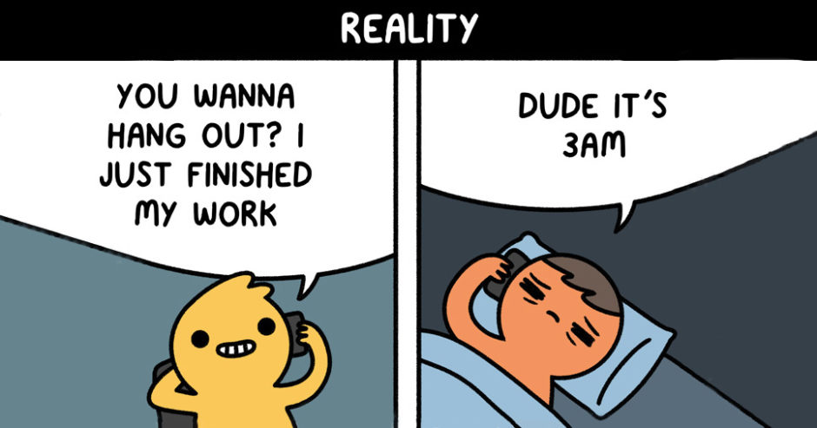
Module Expectations
Programming is a very practical subject.
It isn’t easy.
It requires commitment, effort and practice (both here and independently).
Disclaimer : Your program may not run first time (this is normal, trust me!).
Don’t leave things too late! (questions, revision, work).
If you experience any issues or have questions, ASK!
Remember the rules of battle engagement!

Slide 9
Rule of engagement
Why do we fall sir? So that we can learn to pick ourselves up .
You only truly fail, if you stop trying. This is fundamental to learning.
If you don’t understand or something isn’t clear, ASK!
You’re investing a lot of time, energy and money in your own development.
I’m here to help you get the best education you can.
Relax and Enjoy.
We are all here to learn.
Let me know what you think.
Feedback from you is important too! It enables me to develop to.
Notes:
Alfred Pennyworth – Batman Begins

Slide 10

What is Programming?
Programming is how we as humans get computers to solve problems
As a Programmer, it is our job to define a sequence of explicit instructions which a computer will follow.
This is both an art and a science.
Everything you have used a computer for involves running a program.
Switching it on.
Liking photos on social media.
Setting the timer on the microwave to 59 seconds to cook. minute rice (because you like to live dangerously).
Notes:
Computers : I don’t just mean desktops and laptops. Look at everything electronic around you. Mobile phones, toasters, Smart watch, washing machine, car…

Slide 11
Why do I need programming?
Software Engineering, Computer Science and Games | Computing Forensics and Security | Networking | General computing
Programming is a central part of your course. | Require an insight into the functioning of programs in order to analyse computers and data. | Network managers often use scripting languages to remotely control machines on a network. | You are expected to have some knowledge of a vast range of topics as you have more flexibility in your choices as you progress
You all to work and develop problem-solving and analytical skills
Notes:
But what ever pathway you are on. Programming and the skills you will develop are a critical to your success!

Slide 12
Programming Languages
Machine language or machine code is the language that the computer uses internally
Referred to as Low-level programming
Difficult to write so humans rarely program in this language
Instead we use higher level languages that are more human-readable
Use a special program to translate the high-level language into machine language.
This translation step can be done in different ways:
Compiling - In advance before you need the program.
Interpreting - On demand, only when you run the program.
Part-compiled - Or a combination of the above.
Notes:
Unfortunately, computers don’t understand languages like English or Spanish, so we must use a programming language to construct instructions that they will understand.
Machine language or machine code is the language that the computer uses internally
Difficult to write so humans rarely program in this language
Referred to as Low-level programming
Instead we use higher level languages that are more human-readable
Use a special program to translate the high-level language into machine language
This translation step can be done in different ways:
Compiling - In advance before you need the program
Interpreting - On demand, only when you run the program
Part-compiled - Or a combination of the above

Slide 13
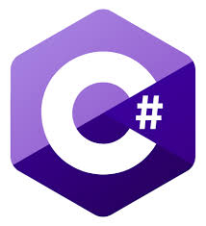





Programming Languages…
Throughout your studies you will come across several different languages
But how am I going to learn so many languages?
Don’t compare this with learning human languages.
The various Programming languages have a lot of commonalties
Notes:
As a programmer understanding the fundamental concepts enables you to learn new languages quickly !
We improvise, adapt and overcome.
Learning different languages is critical as each has their own advantages and disadvantages under the context it is used.

Slide 14

Problem : Making a cup of Tea
Have a think about how you would make a cup of Tea.
Write down a series of explicit and unambiguous instructions that detail every single step.
Whilst I make one
Notes:
Rule one of Dan’s Lectures. Bring things that allows you to take notes!
Pen, Pencil, Crayons and paper.
iPad or Laptop.
My modules require you to not only use a machine, but also solve problems on paper too!
I expect you to take notes. Not everything that I say will be included on the slides, but it may be included on the exam.

Slide 15

Discussion : Making a cup of Tea
I assumed that you made a cup of tea at some point, lets be honest its not difficult. However as a programmer…
We implement solutions to problems by breaking the problem in to small, manageable, explicit and unambiguous steps.
There are numerous ways to solve the same problem.
Just because your way is different doesn’t mean it its wrong
But with great power comes great responsibility!
A Program will only do EXACTLY what we tell it to and if we are not careful,
it may also do things that we don’t want it to do too.
Notes:
We as programmers we solve problems by breaking them down into smaller more manageable, explicit unambiguous steps.
Think building a LEGO! Each brick on it’s own isn’t worth very much but together, following the right steps, you can build a bat mobile.
Remember a computer is stupid! It doesn’t know anything of the world, it just does things we tell it!
There are many ways to solve the same problem. Just because your way is different doesn’t mean it its wrong*.
It allows us to develop as a Programmer. We can assess the solution from varies different perspectives. For example, is it the most optimal? Is the quickest? Does it use the least CPU cycles? Or even is the solution understandable to another developer?
However, with great power comes great responsibility. A Program will only do EXACTLY what we tell it to and if we are not careful, it might also do things that we don’t want it to do.

Slide 16
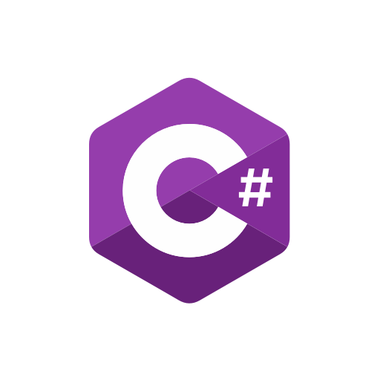


So what are we using for this module?
Programming Language : C#
Integrated Development Environment : Microsoft Visual Studio
Notes:
C# (pronounced C-Sharp, like the musical note) is a general purpose, multi paradigm programming language developed by Microsoft that runs on the .NET Framework. C# is used to develop web apps, desktop apps, mobile apps, games and much more.

Slide 17
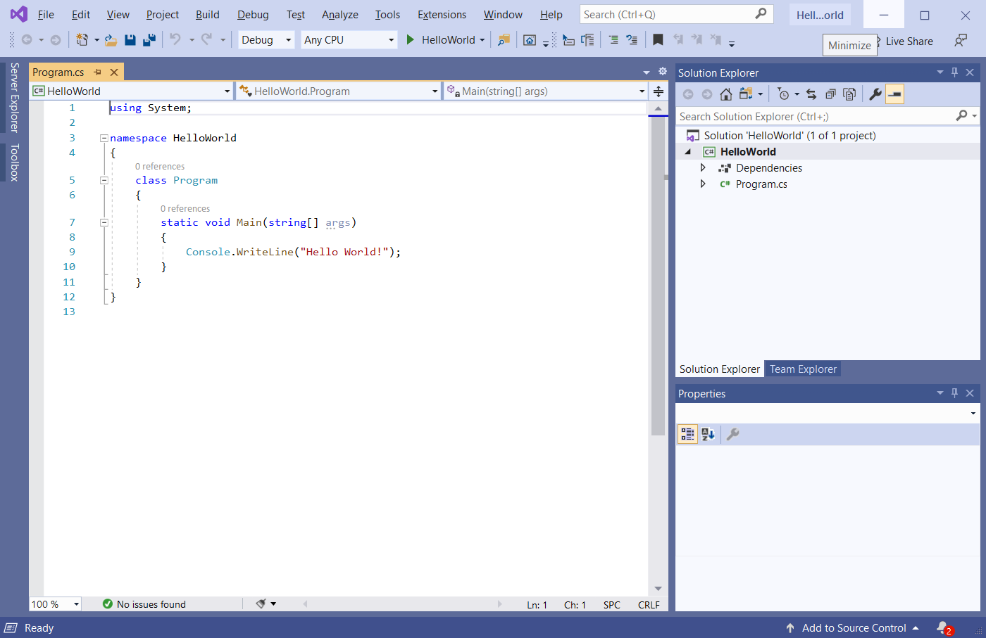
Development Environment : Windows
Notes:
Now depending on your operating system and the version of Visual Studio you install you may see slight variations regarding the User Interface. Don’t worry. The core aspects are present in all versions and we will be only using the basic features for this module.

Slide 18
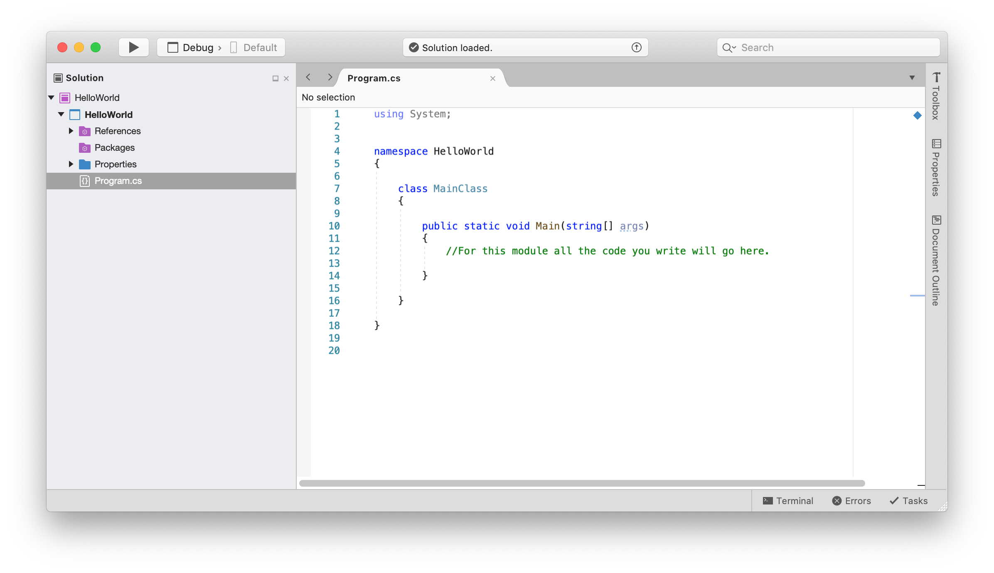
Development Environment : Mac
Notes:
Here is Visual Studio running on the Mac. Notice a clear difference between the this and the Windows Version.

Slide 19
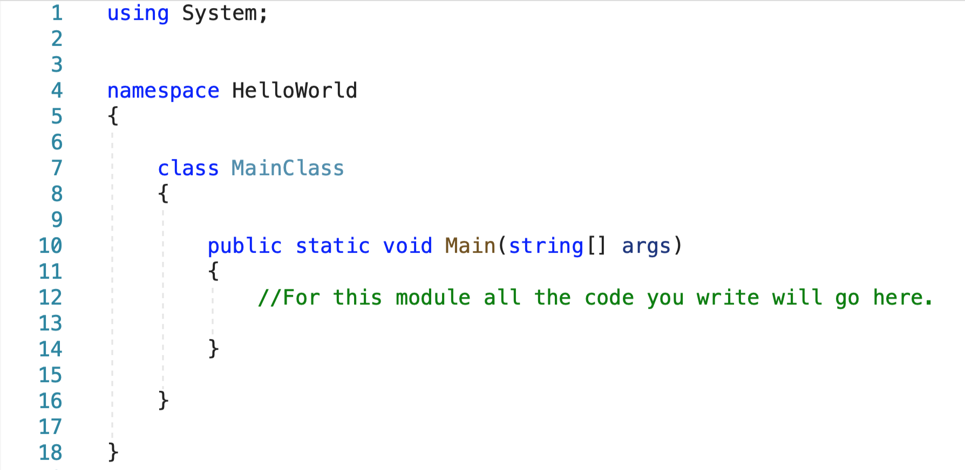
Hello World!
Some text
Some text
Some text
Some text
Notes:
What is consistent between the two is the code. As previously mentioned we are going to use C#. When you create your first project, visual studio is kind enough to generate a project and pre populate some files with ‘boiler-plate’ code. Boiler plate code is just sections of code that have to be included in many places with little or no alteration, consider the IDE saving you time be automatically generating the code above.
So what does it all mean? Well Lets run through it beginning at line 1. The using statements indicate what parts of the pre-written C# library code our program will use. If we want special features (e.g. file features, network features) then we add more using lines here. Consider these like Lego sets, that we can reuse to provide features to your application.
The namespace line, which has the name of your project, ensures your project is kept separate from other projects and system code
Notice the curly brackets or braces – the symbols { and } . They keep the code into blocks. The braces are joined with a dotted line so you can see where each one starts and ends.
The class MainClass and the line marked Main are the part that will contain your code in your early programming .
Finally, your code goes inside the innermost braces { } . So make a new blank line in- between them and let’s start programming.

Slide 20
In Summary
In today’s lecture we have discussed:
The module, assessment and expectations [ TO.1 ]
What is programming [ TO.2 ]
In the practical element we are going to apply our new theoretical knowledge and :
Familiarise yourself with the IDE [ PO.1 ]

Slide 21

Questions?

Slide 22
What’s Next?
Week 1 Lab – Introduction to Visual Studio
Week 2 Lecture – Variables, Operators, and Conditions
Bring something to take notes!
Announcement/s:
CO1404 – Intro to Programming Teams Channel !

